Slide 1

The Development of
Mellanox - NVIDIA GPUDirect over InfiniBand
A New Model for GPU to GPU Communications
Gilad Shainer

Slide 2
Overview
The GPUDirect project was announced Nov 2009
  “NVIDIA Tesla GPUs To Communicate Faster Over Mellanox InfiniBand Networks”
  http://www.nvidia.com/object/io_1258539409179.html
GPUDirect was developed by Mellanox and NVIDIA
  New interface (API) within the Tesla GPU driver
  New interface within the Mellanox InfiniBand drivers
  Linux kernel modification
GPUDirect availability was announced May 2010
  “Mellanox Scalable HPC Solutions with NVIDIA GPUDirect Technology Enhance GPU-Based HPC Performance and Efficiency”
  http://www.mellanox.com/content/pages.php?pg=press_release_item&rec_id=427

Slide 3
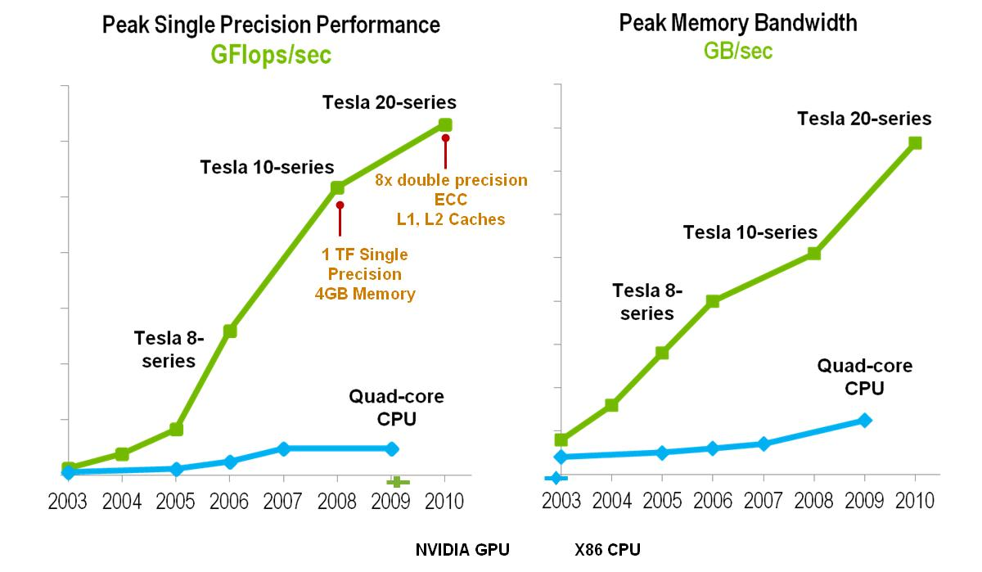
Why GPU Computing?
GPUs provide cost effective way for building supercomputers
Dense packaging of compute flops with high memory bandwidth

Slide 4







The InfiniBand Architecture
Industry standard defined by the InfiniBand Trade Association
Defines System Area Network architecture
  Comprehensive specification:
  from physical to applications
Architecture supports
  Host Channel Adapters (HCA)
  Target Channel Adapters (TCA)
  Switches
  Routers
Facilitated HW design for
  Low latency / high bandwidth
  Transport offload
Processor
Node
Processor
Node
HCA
InfiniBand
Subnet
Consoles
HCA
Processor
Node
HCA
Switch
Switch
HCA
Subnet
Manager
Switch
Switch
TCA
Gateway
TCA
Gateway
RAID
Fibre
Channel
Storage
Subsystem
Ethernet
4

Slide 5
InfiniBand Link Speed Roadmap
# of Lanes per direction | Per Lane & Rounded Per Link Bandwidth (Gb/s)
 | 5G-IB DDR | 10G-IB QDR | 14G-IB-FDR (14.025) | 26G-IB-EDR (25.78125)
12 | 60+60 | 120+120 | 168+168 | 300+300
8 | 40+40 | 80+80 | 112+112 | 200+200
4 | 20+20 | 40+40 | 56+56 | 100+100
1 | 5+5 | 10+10 | 14+14 | 25+25
12x NDR
12x HDR
300G-IB-EDR
168G-IB-FDR
8x NDR
8x HDR
120G-IB-QDR
4x NDR
200G-IB-EDR
112G-IB-FDR
4x HDR
60G-IB-DDR
Bandwidth per direction (Gb/s)
80G-IB-QDR
100G-IB-EDR
56G-IB-FDR
x12
1x NDR
x8
1x HDR
40G-IB-DDR
40G-IB-QDR
25G-IB-EDR
14G-IB-FDR
x4
20G-IB-DDR
10G-IB-QDR
x1
Market
Demand
2005
-
2006
-
2007
-
2008
-
2009
-
2010
-
2011
2014
Notes:
5

Slide 6
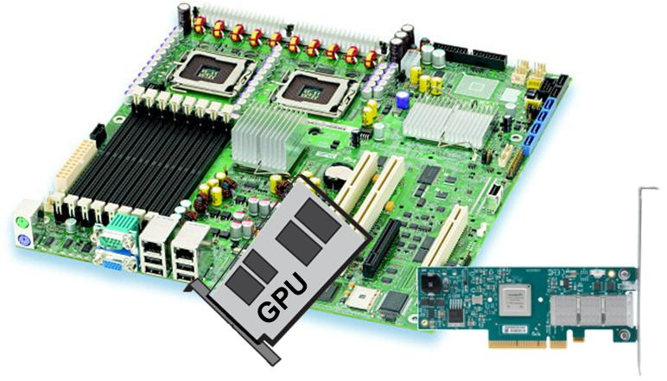
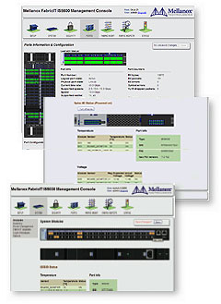
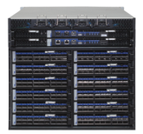
Efficient HPC
Offloading
Messaging Accelerations
MPI
CORE-Direct
Management
Adaptive Routing
GPUDirect
Congestion Control
Advanced
Auto-negotiation

Slide 7
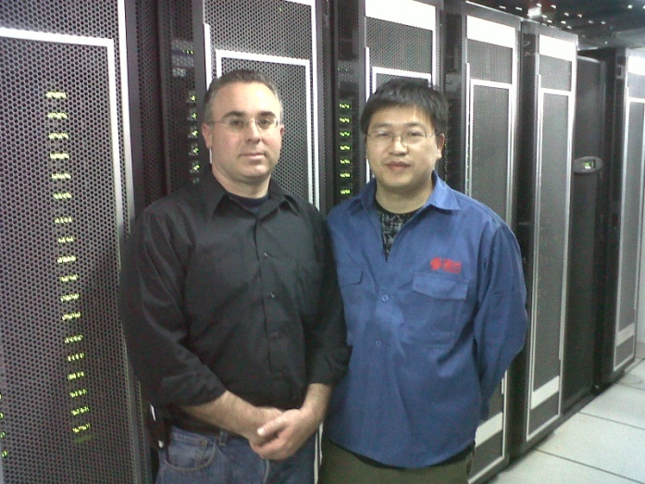
GPU – InfiniBand Based Supercomputers
GPU-InfiniBand architecture enables cost/effective supercomputers
  Lower system cost, less space, lower power/cooling costs
Mellanox IB – GPU PetaScale Supercomputer (#2 on the Top500)
National Supercomputing Centre in Shenzhen (NSCS)
5K end-points (nodes)

Slide 8
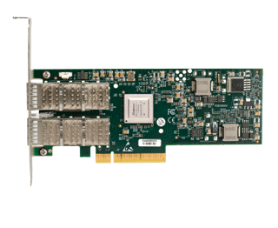
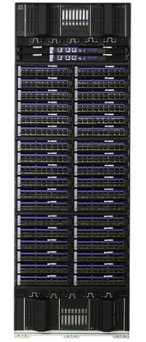
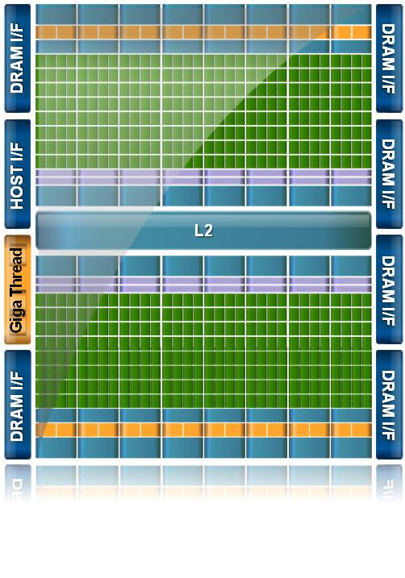
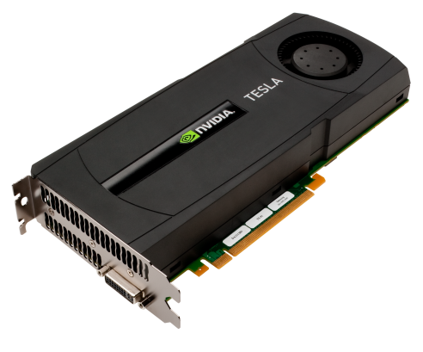
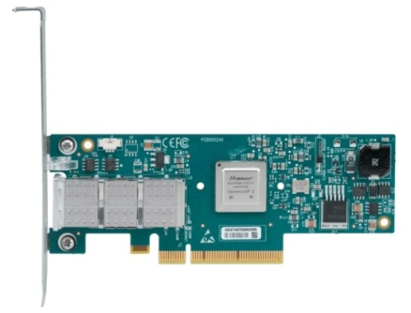
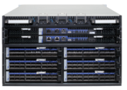


GPUs – InfiniBand Balanced Supercomputers
GPUs introduce higher demands on the cluster communication
CPU GPU
Data
Data
Network
Data
NVIDIA “Fermi”
512 cores
Must be
Balanced
Must be
Balanced

Slide 9
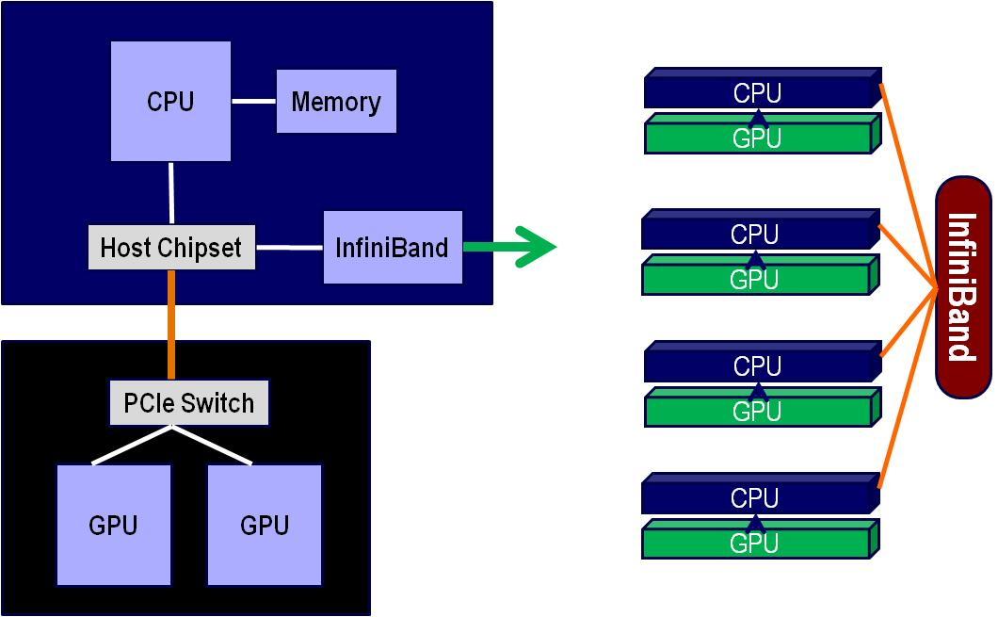
System Architecture
The InfiniBand Architecture (IBA) is an industry-standard fabric designed to provide high bandwidth, low-latency computing, scalability for ten-thousand nodes and multiple CPU/GPU cores per server platform and efficient utilization of compute processing resources.
  40Gb/s of bandwidth node to node
  Up to 120Gb/s between switches
  Latency of 1μsec

Slide 10
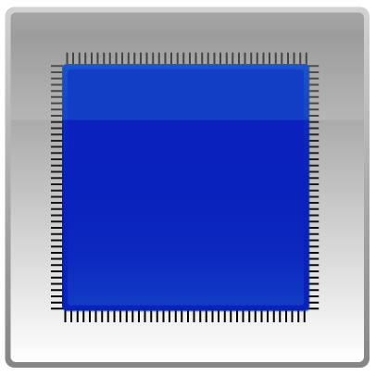




GPU-InfiniBand Bottleneck (pre-GPUDirect)
For GPU communications “pinned” buffers are used
  A section in the host memory dedicated for the GPU
  Allows optimizations such as write-combining and overlapping GPU computation and data transfer for best performance
InfiniBand uses “pinned” buffers for efficient RDMA
  Zero-copy data transfers, Kernel bypass
CPU
System
Memory
Chip
set
GPU
InfiniBand
GPU
Memory

Slide 11
GPU-InfiniBand Bottleneck (pre-GPUDirect)
The CPU has to be involved GPU to GPU data path
  For example: memory copies between the different “pinned buffers”
  Slow down the GPU communications and creates communication bottleneck
Receive
Transmit
2
System
Memory
2
System
Memory
CPU
1
CPU
1
Chip
set
GPU
Chip
set
GPU
InfiniBand
InfiniBand
GPU
Memory
GPU
Memory

Slide 12
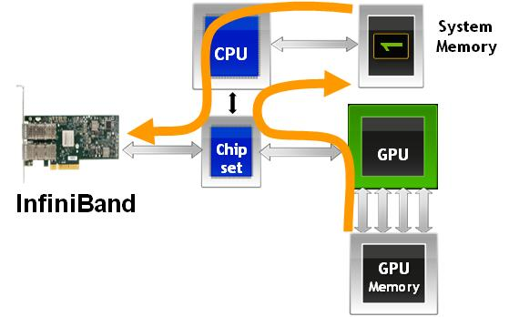
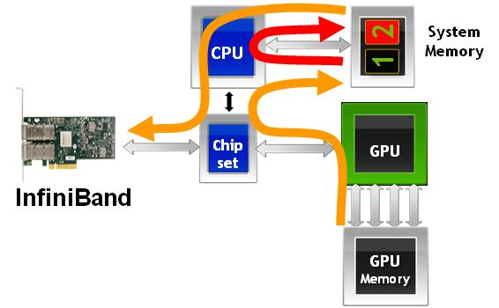
Mellanox – NVIDIA GPUDirect Technology
Allows Mellanox InfiniBand and NVIDIA GPU to communicate faster
  Eliminates memory copies between InfiniBand and GPU
GPUDirect
No GPUDirect
Mellanox-NVIDIA GPUDirect Enables Fastest GPU-to-GPU Communications

Slide 13
GPUDirect Elements
Linux Kernel modifications
  Support for sharing pinned pages between different drivers
  Linux Kernel Memory Manager (MM) allows NVIDIA and Mellanox drivers to share the host memory
    Provides direct access for the latter to the buffers allocated by NVIDIA CUDA library, and thus, providing Zero Copy of data and better performance
NVIDIA driver
  Allocated buffers by the CUDA library are managed by the NVIDIA Tesla driver
  Modifications to mark these pages to be shared so the Kernel MM will allows the Mellanox InfiniBand drivers to access them and use them for transportation without the need for copying or re-pinning them.
Mellanox driver
  The InfiniBand application running over Mellanox InfiniBand adapters can transfer the data that resides on the buffers allocated by the NVIDIA Tesla driver
  Modifications to query this memory and to be able to share it with the NVIDIA Tesla drivers using the new Linux Kernel MM API
  Mellanox driver registers special callbacks to allow other drivers sharing the memory to notify any changes performed during run time in the shared buffers state, in order for the Mellanox driver to use the memory accordingly and to avoid invalid access to any shared pinned buffers

Slide 14
Accelerating GPU Based Supercomputing
Fast GPU to GPU communications
Native RDMA for efficient data transfer
Reduces latency by 30% for GPUs communication
Receive
Transmit
System
Memory
System
Memory
CPU
1
CPU
1
Chip
set
GPU
Chip
set
GPU
InfiniBand
InfiniBand
GPU
Memory
GPU
Memory

Slide 15
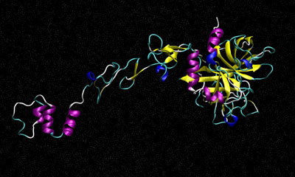
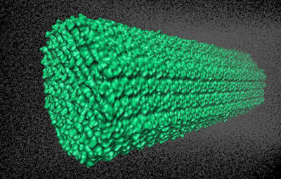
Applications Performance - Amber
Amber is a molecular dynamics software package
  One of the most widely used programs for bimolecular studies
  Extensive user base
  Molecular dynamics simulations calculate the motion of atoms
Benchmarks
  FactorIX - simulates the blood coagulation factor IX, consists of 90,906 atoms
  Cellulose - simulates a cellulose fiber, consists of 408,609 atoms
  Using the PMEMD simulation program for Amber
Benchmarking system – 8-node system
  Mellanox ConnectX-2 adapters and InfiniBand switches
  Each node includes one NVIDIA Fermi C2050 GPU
FactorIX
Cellulose

Slide 16
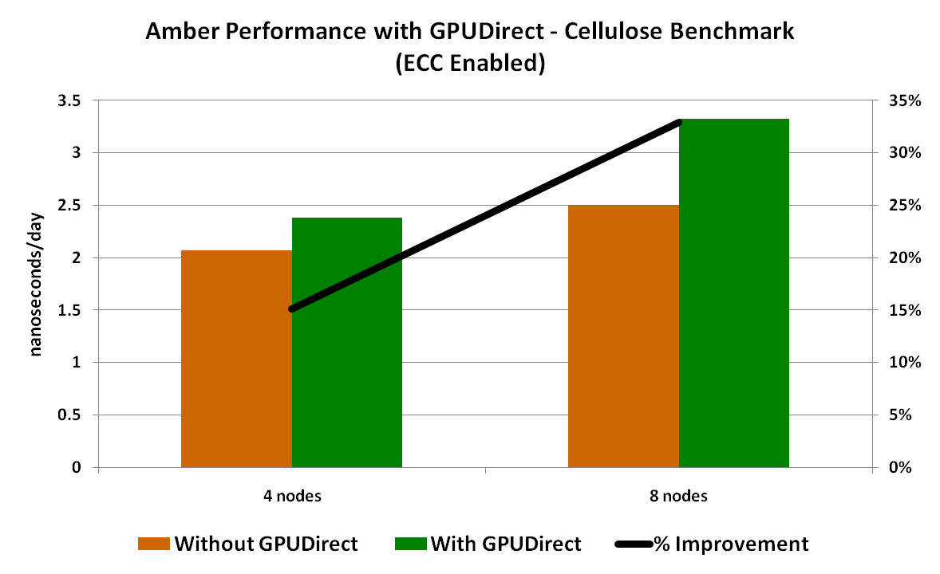
Amber Performance with GPUDirect
Cellulose Benchmark
33% performance increase with GPUDirect
Performance benefit increases with cluster size

Slide 17
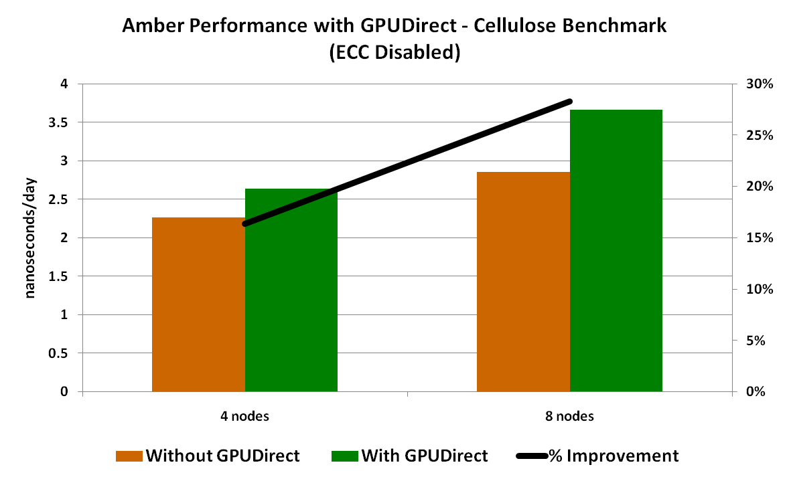
Amber Performance with GPUDirect
Cellulose Benchmark
29% performance increase with GPUDirect
Performance benefit increases with cluster size

Slide 18
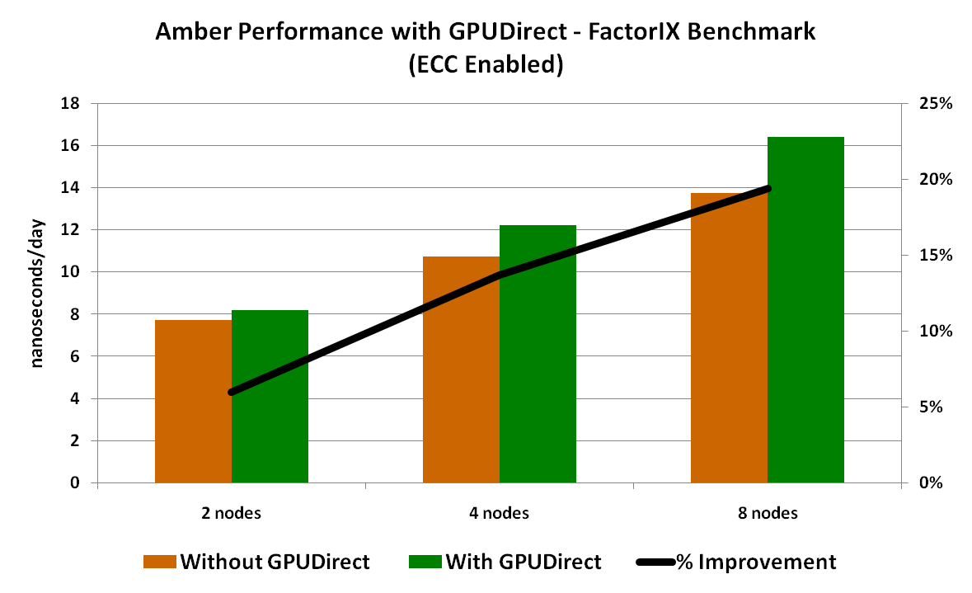
Amber Performance with GPUDirect
FactorIX Benchmark
20% performance increase with GPUDirect
Performance benefit increases with cluster size

Slide 19
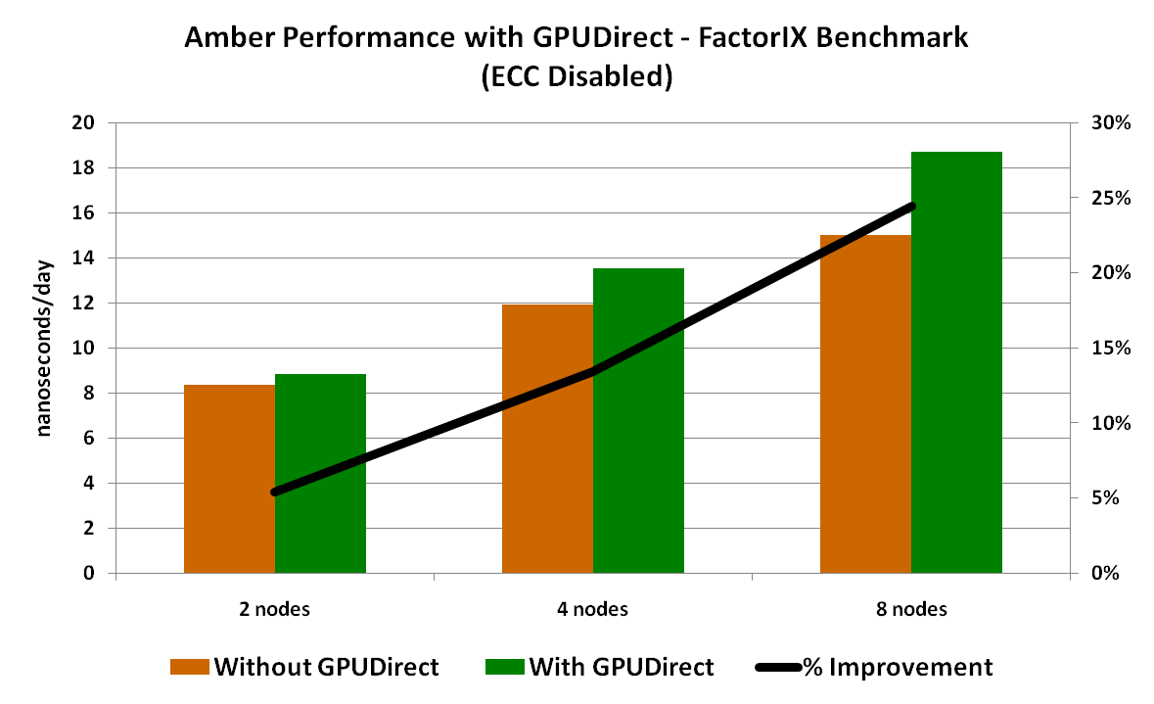
Amber Performance with GPUDirect
FactorIX Benchmark
25% performance increase with GPUDirect
Performance benefit increases with cluster size

Slide 20
Summary
GPUDirect enables the first phase of direct GPU-Interconnect connectivity
Essential step towards efficient GPU Exa-scale computing
Performance benefits range depending on application and platform
  From 5-10% for Linpack, to 33% for Amber
  Further testing will include more applications/platforms
The work presented was supported by the HPC Advisory Council
  http://www.hpcadvisorycouncil.com/
  World-wide HPC organization (160 members)

Slide 21










































































































































HPC Advisory Council Members

Slide 22
HPC@mellanox.com

